Slide 1
Recitation#7
TA: Tatheer Zahra (tzz5184@psu.edu)

Slide 2
Important Announcements
Grades for L.6, A.1 have been uploaded.
L.7 is due this Friday. Submissions after 5 will have a 10% deduction.
Please check Canvas for announcements from Dan Kahn. We have Q.1 next week. Details in his announcement.
Deadlines to submit team members is this Friday.

Slide 3
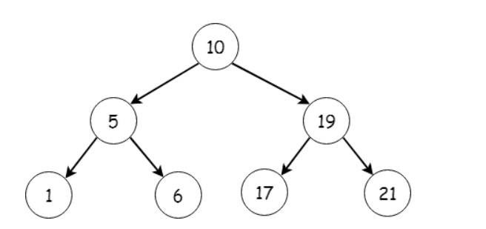
Review on Module 7
What is backtracking?
A function calling itself
How to traverse this tree?

Slide 4
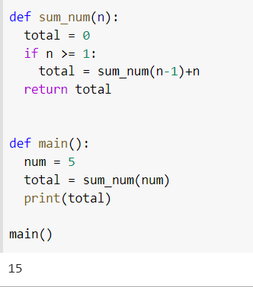
L.6 – Recap of recursion

Slide 5
Prepare for timed test
Sign into canvas and pull up the recitation page on the lab computer ​​
Clear workspace (no notes, no phones, all away)​
You will hear me call out time warnings. Please manage your time!​​
Raise your hand if you have any questions ​​
Remember this timed test only covers material from A.1
Can refer to Syllabus “Important” section for prohibited constructs​
Don’t need comment header or specific file name (only for lab assignments)​
When you are done, take a picture of your submission page and sign out with the LA at the front.

Slide 6
Timed Test
Time test will be due in 30 minutes​​. You should mark your attendance after 30 minutes to be considered for grading.
Read the instructions carefully.
If you have a question, raise your hands.
Password: whyIsItRaining

